Slide 1

TABLEAU CAPSTONE PROJECT
JAN’ 21
Submitted By:
SIMRAN KUMARI

Slide 2
CREDIT CARD CUSTOMERS
Data Source Link: https://www.kaggle.com/sakshigoyal7/credit-card-customers
About Data Set: A manager at the bank is disturbed with more and more customers leaving their credit card services. They would really appreciate if one could predict for them who is going to get churned so they can proactively go to the customer to provide them better services and turn customers' decisions in the opposite direction.

Slide 3
Problem Statements from the Data Set:
How is the credit limit of customers varies with particular age group, education level and within a particular income category?
Total Transaction Amount data with different income category and customer’s marital status?
What’s the income category of customers with different marital status and gender?
Total Revolving Balance of a particular income category and with certain credit limits?
Income Category varies with Gender.
Gender Performance with different Measure parameter created like attrition ,months inactive for 12 mon, customer age, credit limit and so on.
Different card category with credit limit of customers.
Total Transaction Amount and Trans. Count

Slide 4
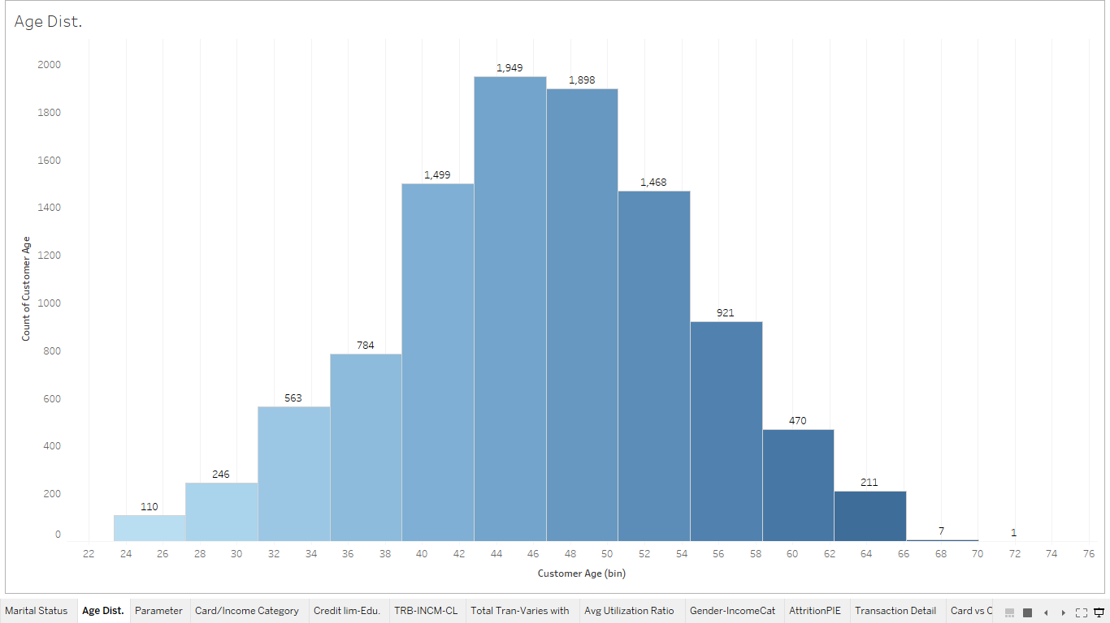
AGE DISTRIBUTION
-Created a age bin.
-Most of the customers are of age group 45 with total count of 1,949.

Slide 5
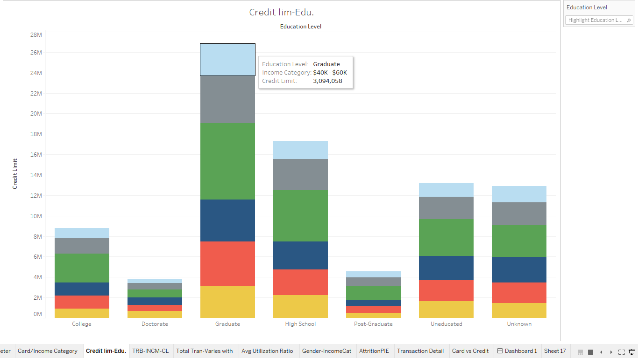
Education level-Income category-credit limit
-From this chart we get the credit limit detail for different income category customers of diff. education level.
-Chart shows Graduates in income category $80K-$120K having the highest credit limit.

Slide 6
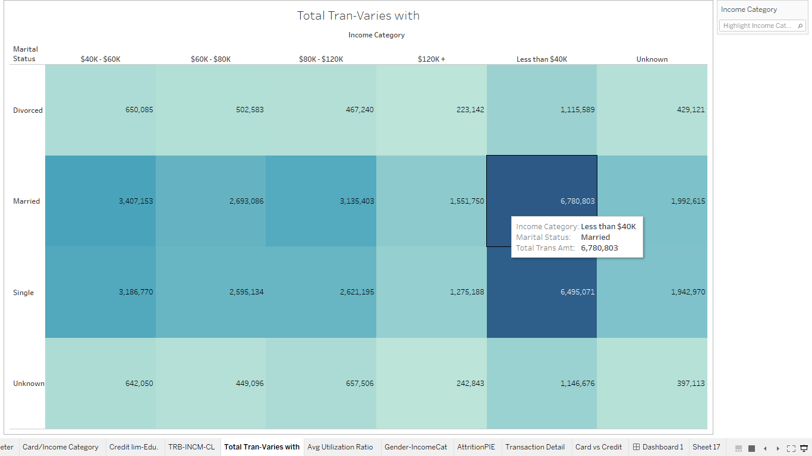
Total Transaction Amount-Income category-Marital Status
-This is a heat mapping of customer’s total transaction amount falling in diff. income category with what the marital status is.
Chart shows that customers who are married and falls under the less than $40K income category having the highest total transaction amount with 6,780,803.
-That means they are highly engaged with the credit card usages.

Slide 7
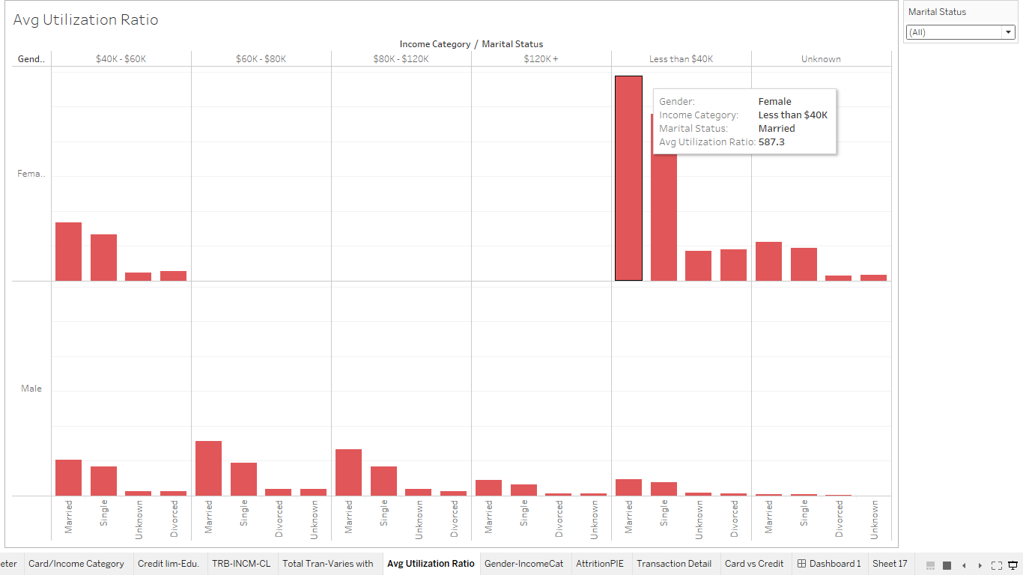
Avg. Utilization Ratio-Gender-Income category-Marital Status
-Comparison of customers Avg utilization ratio across different income category, marital status and gender.
-Chart shows that Married female falling under the income category of less than $40K having highest avg. utilization ratio of 587.3.
- Credit utilization considered to be the 2nd highest factor credit companies consider when determining credit score. Highest utilization ratio indicates overspending and that can negatively impact the credit score.

Slide 8
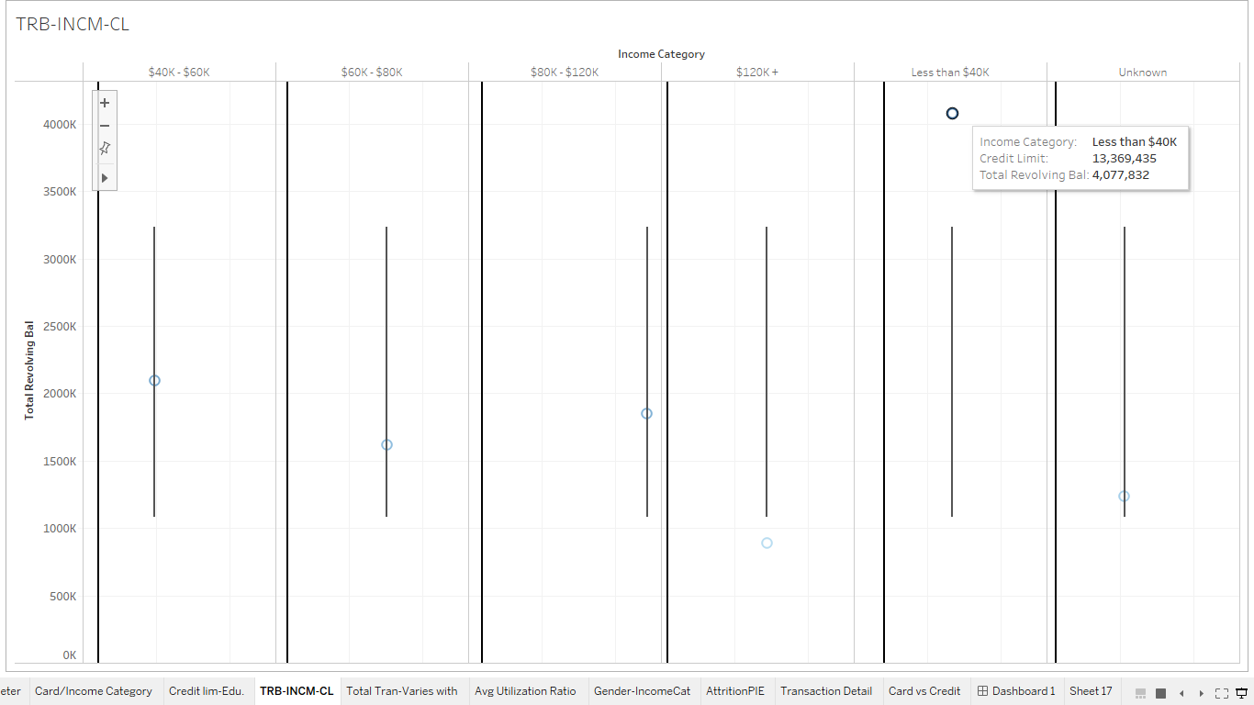
Total revolving balance-Income category-Credit limit
-This is a scatter plot of the total revolving balance of customers across different income category and credit limit.
-Chart shows customers falling into income category of less than $40K having the highest total revolving amount.
-A revolving balance is the portion of credit card spending that goes unpaid at the end of a billing cycle. High revolving balance can lead to bad credit score if not managed properly.

Slide 9
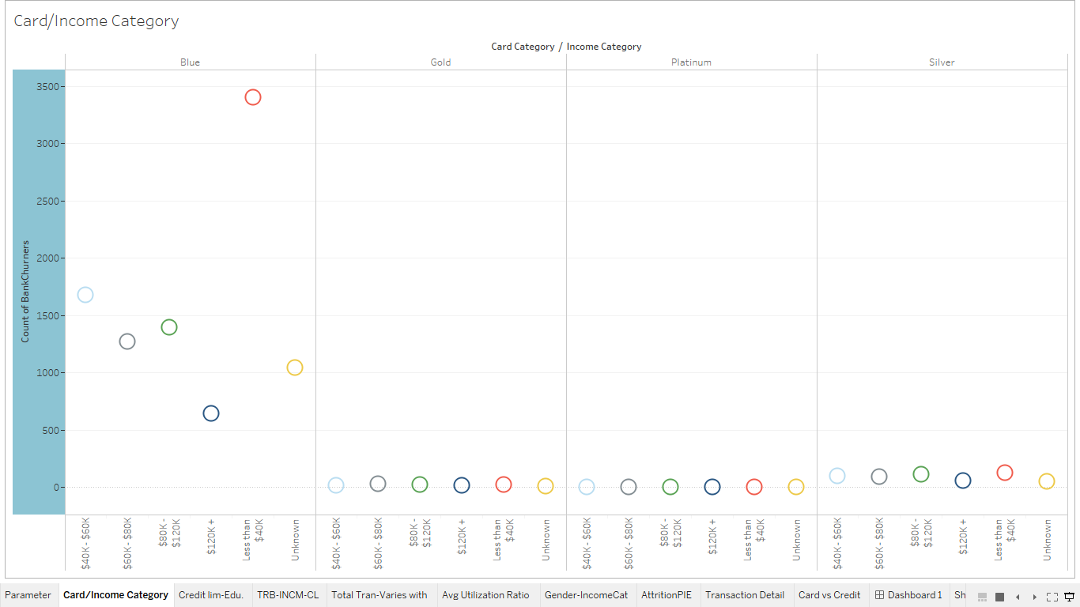
Card Type-Income category
This scatter plot shows the card category held by customers of different income category and their count.
So, customers in the income category less than $40K having the highest count of holding Blue card.

Slide 10
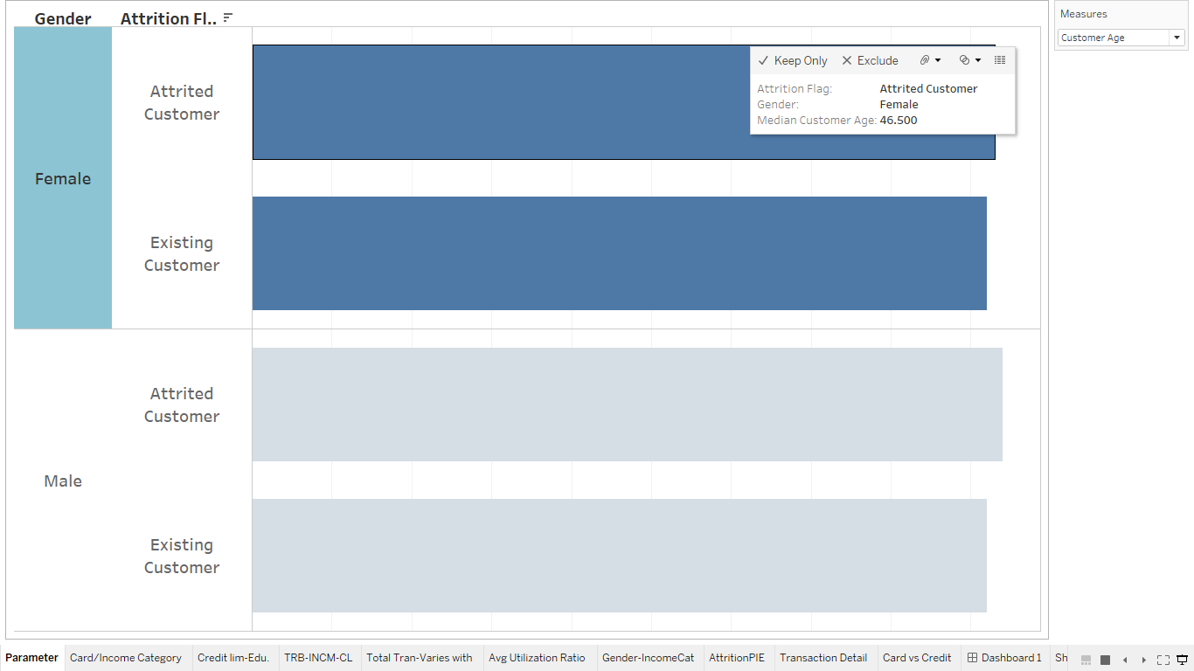
Gender wise data compared with different measures
- A Gender perspective analysis across different measures like attrition flag, credit limit, total transaction amount and count and so on.

Slide 11
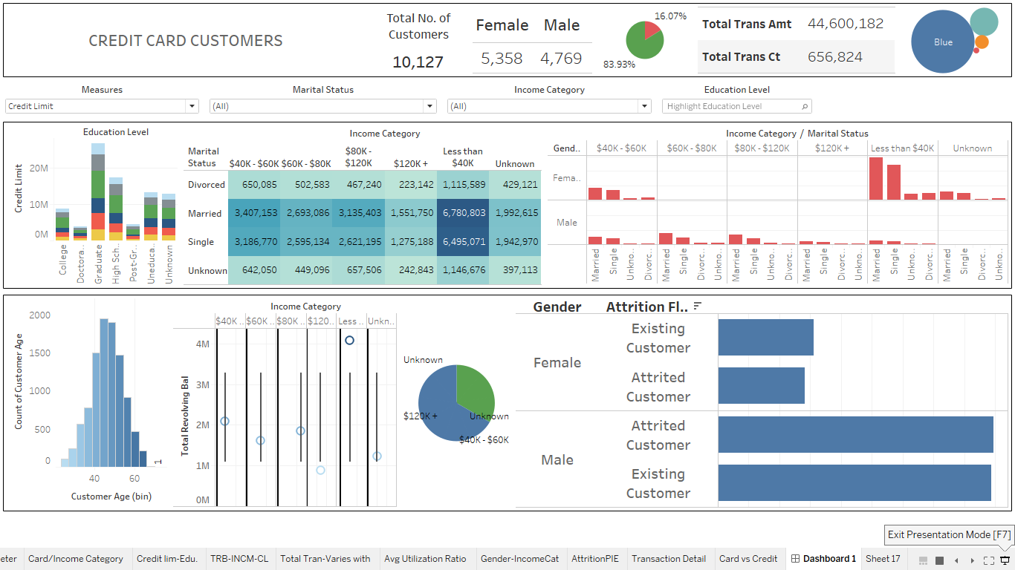

Slide 12
Executive Summary
Graduates in the income category of $80K-$120K having highest credit limit should be the main target for among existing customers in attrition flag.
The Gender analysis across different measures shows Female existing customers have highest total transaction amount and count, Male attributed have highest dependent count, Both male and female attributed customers have almost equal Months Inactive for12 mon and months on book and credit limit of male attrited customers were highest.
Married and falls under the less than $40K income category having the highest total transaction amount with 6,780,803 , That means they are highly engaged with the credit card usages.
Married female falling under the income category of less than $40K having highest avg. utilization ratio of 587.3. Highest utilization ratio indicates overspending and that can negatively impact the credit score.
Customers falling into income category of less than $40K having the highest total revolving amount. High revolving balance can lead to bad credit score if not managed properly.
Customers in the income category less than $40K having the highest count of holding Blue card.

Slide 13
Thank You
Presentation Video Link-
Youtube: https://youtu.be/vMyhlOEy_IY
Drive: https://drive.google.com/file/d/17uabZhf1ANo2sbAucfr3zoQTRKZxdAn3/view?usp=sharing
Tableau Public Link of the workbook: https://public.tableau.com/views/TableauCapstoneProjectSIMRANKUMARI/Dashboard1?:language=en&:display_count=y&:origin=viz_share_link
Tableau Workbook:

